Slide 1
Machine Learning & Artificial Intelligence
Cybersecurity
Lesson 2.1

Slide 2
By the end of today’s class, you will understand the following concepts:
1
Definition of AI and ML
2
Differences between AI and traditional programming
3
Types of AI (narrow AI vs. general AI)
4
Importance of AI and ML in cybersecurity
5
Ethics and bias in AI
6
ChatGPT and similar tools in cybersecurity

Slide 3

Artificial Intelligence
And Machine Learning

Slide 4
Logic Theorist,
developed in the 1950s,
simulates how individuals solve complex problems.

Slide 5
What is artificial intelligence (AI)?

Slide 6
Artificial Intelligence is the simulation of human intelligence processes by machines, particularly computer systems.

Slide 7

Artificial Intelligence
It enables machines to perform tasks that typically require human intelligence, such as learning, reasoning, and problem-solving.
Common applications:
Voice assistants: Siri and Alexa use AI to understand and respond to voice commands.
Self-driving cars: These vehicles use AI to navigate and make driving decisions autonomously.
Recommendation systems: AI powers the algorithms that suggest shows on Netflix or products on Amazon based on your preferences.

Slide 8
What is machine learning (ML)?
‹#›

Slide 9
Machine Learning
enables computer algorithms to learn from data and then make decisions or predictions about future data.

Slide 10

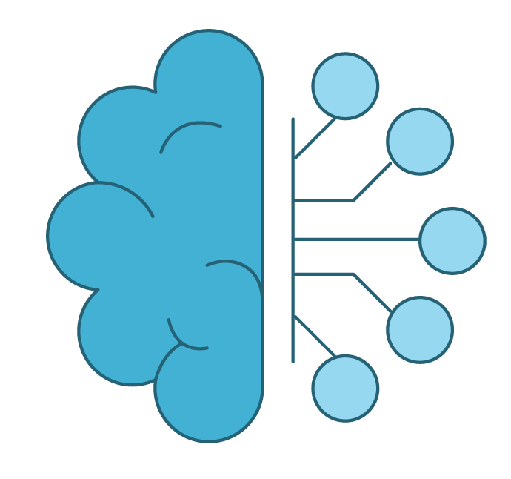
Machine Learning
Produces predictive models and makes predictions
Develops rule-based programs with enough data
Crafts and trains models based on
real-world data
Improves by identifying and disregarding outliers
Integrates knowledge to make better predictions
or decisions
Does not rely on programmers to manually instruct the computer on how to improve

Slide 11

Narrow AI vs. General AI
Notes:
shutterstock_650430397

Slide 12

Narrow AI vs. General AI
Narrow AI
General AI
Refers to “intelligent” algorithms designed to perform predetermined tasks
Performs specific tasks
Unable to transfer knowledge
Simulates human consciousness but is not conscious
The self-aware, independent entities of science fiction stories
Performs general tasks with minimal oversight
Knowledge is transferable
Has human-like consciousness
May become possible in the future

Slide 13

Importance of AI and ML in Cybersecurity
01
Analysis of vast amounts of data
02
Threat-detection applications
03
Malware analysis
04
Fraud prevention

Slide 14

Importance of AI and ML in Cybersecurity
05
Enhancement of real-time response
06
Automation of routine tasks
07
Predictive capabilities

Slide 16

Bias and Ethics in AI and ML

Slide 17
Research with AI
Plagiarism involves copying and using another person's ideas, words, or work without proper acknowledgment. Avoid plagiarism by using AI as follows:
Use AI for data analysis.
Generate original insights.
Cross-verify information.
Draft with care.
Maintain academic integrity.

Slide 18

Bias in AI can
occur when AI systems make decisions that reflect human prejudices, leading to unfair or discriminatory
outcomes.
Notes:
shutterstock_669170791

Slide 19
Bias in AI
Biased training data | Data used to train AI systems may contain inherent biases, which can skew the AI's decision-making process.
Biased algorithms | The algorithms themselves can introduce or amplify bias, affecting the AI's outputs.
Biased human decisions | Human choices in designing and implementing AI can lead to biased systems if not carefully managed.

Slide 20

Real-World Examples
Facial recognition systems: Certain ethnic groups can be misidentified due to biased training data.
Hiring systems: Biased hiring algorithms that favor certain demographics can lead to unequal opportunities.

Slide 21
Examining Accuracy and Bias in AI
In this activity, you will be using the internet to research recent examples of AI problems in accuracy and bias in the news.
20 Minutes

Slide 24


AI and ML in
Data Analysis

Slide 25


AI and ML in Data Analysis
AI and ML revolutionize data analysis.
  Identification of patterns
  Prediction of outcomes
  Detection of anomalies
Data is the foundation of AI and ML.
  Quality and quantity of data impacts AI performance.
  Algorithms perform better with high-quality data.

Slide 26
Pattern Recognition and Anomaly Detection:
Pattern recognition
Anomaly detection
AI and ML models excel at identifying regular patterns within data.
  Behavior of users in network e.g., login times, access patterns, and commonly used apps.
AI can detect deviation easily.
AI and ML are adept at detecting deviation from normal patterns.
  Potential security threats
  Fraudulent activities
  Spike in traffic (potential DDoS attack)

Slide 27





AI and ML Applications in Cybersecurity
Some of the applications in cybersecurity we will be discussing in later modules include:
01
02
03
Intrusion detection systems
Malware detection
Fraud detection
Notes:
Shutterstock_792833623 shutterstock_693068344 shutterstock_693068344.png

Slide 28
Benefits of AI and ML in Data Analysis
01
Speed: Analyzes large volumes quickly with timely insights
02
Accuracy: Improves threat detection accuracy through data analysis
03
Scalability: Handles increasing amounts of data
04
Adaptability: Learns and adapts to new data and potential threats
05
Proactive threat hunting: Analyzes patterns and predicts security incidents

Slide 29
Analysis of Logins and Application Access Patterns

Slide 30
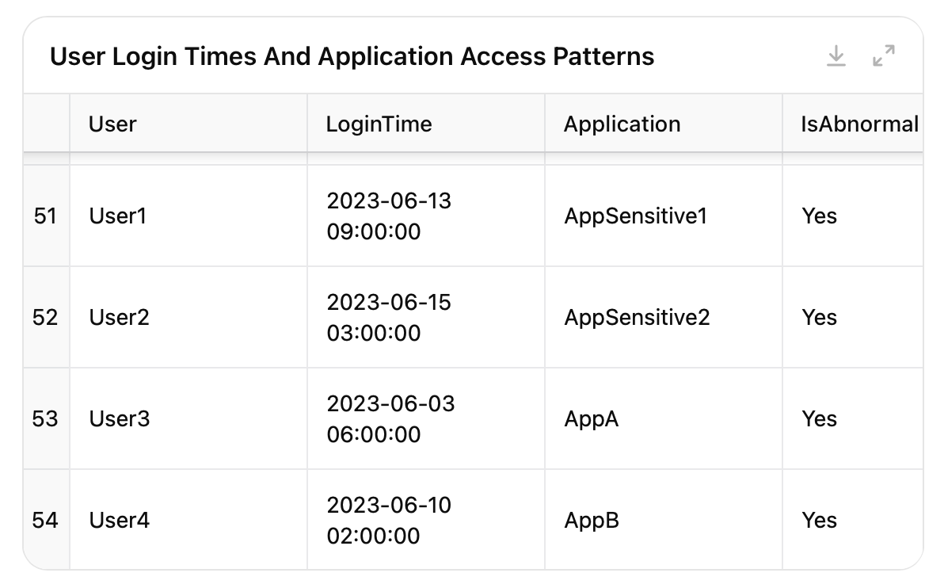
Analysis of Logins and Application Access Patterns: Step 1 – Creating a dataset
Create a dataset of user login times and application access patterns for a network. Include normal behavior (logins between 8am and 6pm, access to specific applications) and a few instances of abnormal behavior (logins at 2am, access to sensitive applications at unusual times). Display the output of this dataset in tabular format highlighting abnormal results.

Slide 31
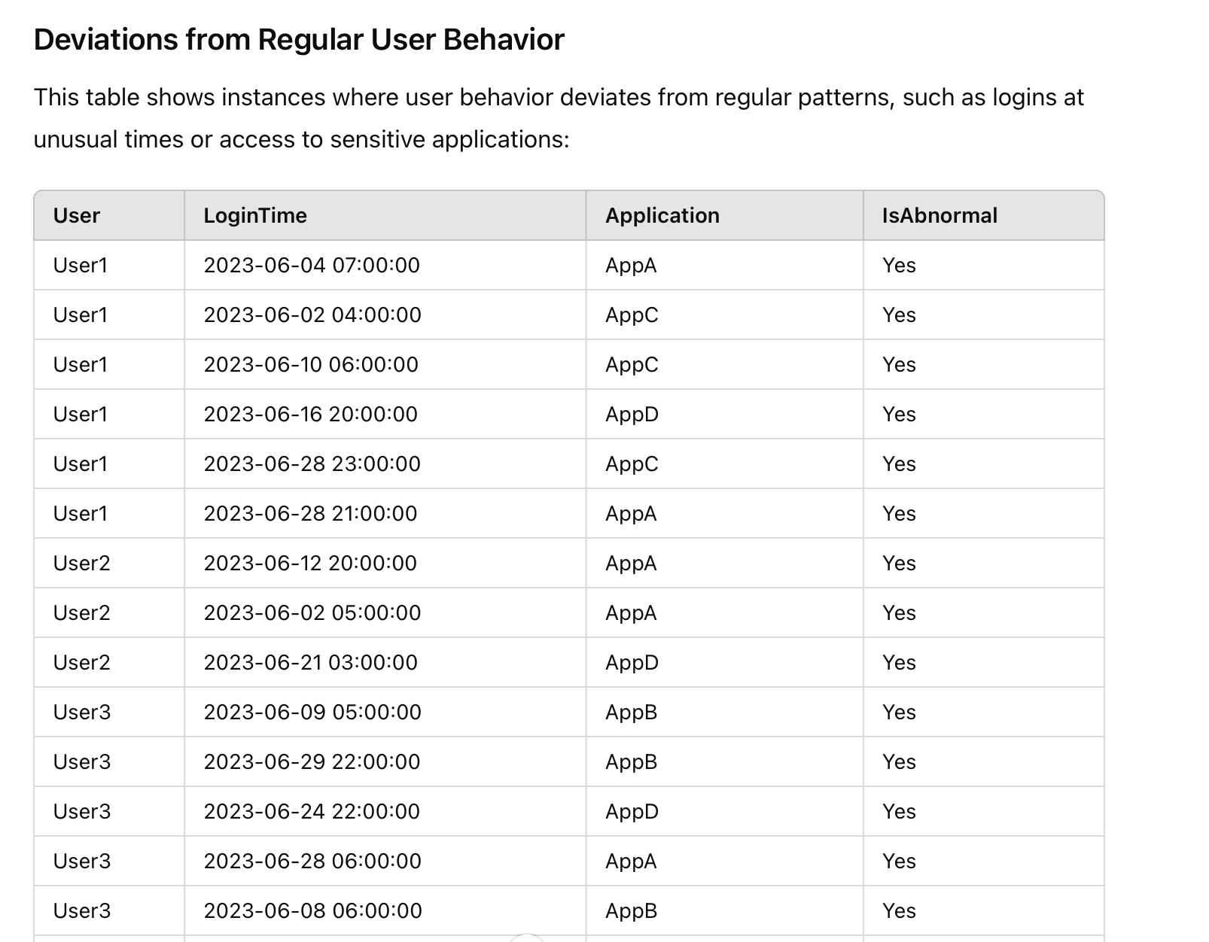
Analysis of Logins and Application Access Patterns: Step 2 – Identifying regular patterns and deviations
Analyze the provided dataset to identify regular user behavior patterns. Highlight any instances where user behavior deviates from these patterns, such as logins at unusual times or access to sensitive applications. Present results in tabular format.

Slide 32
Analysis of Logins and Application Access Patterns: Step 3 – Providing a summary of the deviations
Summarize the deviations in tabular format:
Speed and efficiency
Accuracy
Consistency
Scalability
Real-time analysis

Slide 33

Exploring AI and ML in Anomaly Detection
In this activity, you will use AI to research how AI can detect
anomalies using AI.
20 Minutes

Slide 37

Practical GPT

Slide 38
ChatGPT, developed by OpenAI,
is a type of artificial intelligence model that excels in generating human-like text based on
the input it receives.

Slide 39
Key Aspects of GPT
Generative: GPT can create new content. E.g., it can write essays, generate code, compose poetry, and even answer questions.
Pre-trained: Trained on a large dataset with sources from the internet. Training helps it understand language patterns, grammar, facts, and even some reasoning abilities.
01
02
Transformer: Architecture used in GPT is effective for processing sequences of data, like text.
Applications: GPT can be used for a wide range of applications, including chatbots, language translation, content creation, summarization, and more.
03
04

Slide 40
Examples of How ChatGPT Can Help Cybersecurity
01
Automated threat intelligence
02
Anomaly-detection assistance
03
Incident report generation
04
On-demand training
05
Knowledge base maintenance

Slide 41

ChatGPT is a tool used by cybersecurity professionals and
can assist in the following areas:

Slide 42
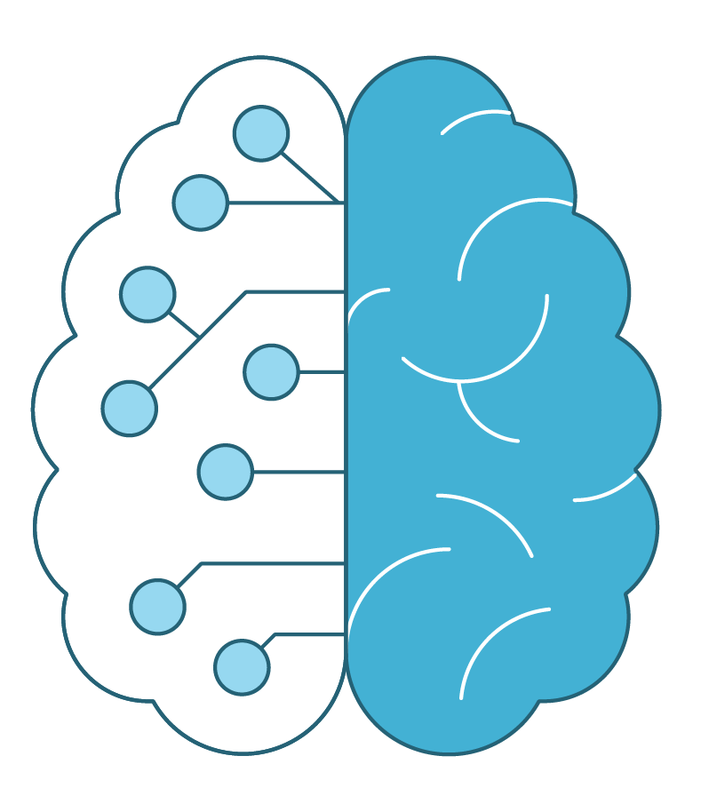
Automated Threat Intelligence
Processes vast amounts of data
Summarizes threat intelligence reports
Stays updated with the latest threats
Extracts key information from threat reports
Presents summaries
Highlights critical details and trends

Slide 43

Anomaly-Detection Assistance
Assists in identifying unusual patterns and anomalies
Analyzes user behavior that might indicate a security breach
Saves time and improves accuracy

Slide 44
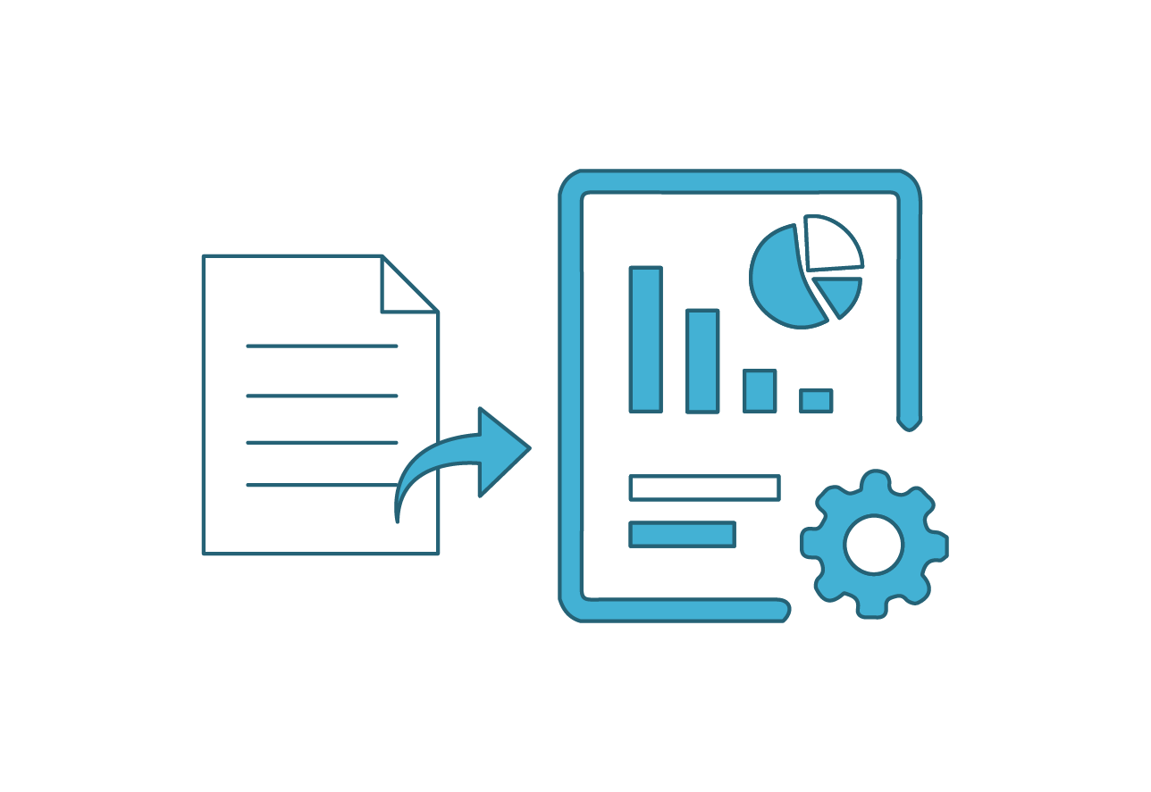
Incident Report Generation
Helps draft detailed incident reports
Organizes and summarizes event details, steps taken, and outcomes
Generates structured report

Slide 45

On-Demand Training
Provides explanations and answers to complex security concepts and procedures
Instructs new personnel on:
  Cybersecurity best practices;
  Protocols; and
  Terminologies

Slide 46

Knowledge Base Maintenance
Helps maintain and update an organization’s knowledge base
Ensures access to the latest information and resources through regular updates

Slide 47
ChatGPT Demo

Slide 48
ChatGPT in Cybersecurity
In this activity, you will explore various prompts within ChatGPT and discuss the responses within your groups.
20 Minutes

Slide 52

Recap
Artificial Intelligence (AI) and Machine Learning (ML)
01
Differences between AI and traditional programming
02
Narrow vs. general AI
03
Importance of AI and ML in cybersecurity
04
Ethics and bias in AI
05
ChatGPT and similar tools in the cybersecurity industry

Slide 54
Thank you

